Slide 1
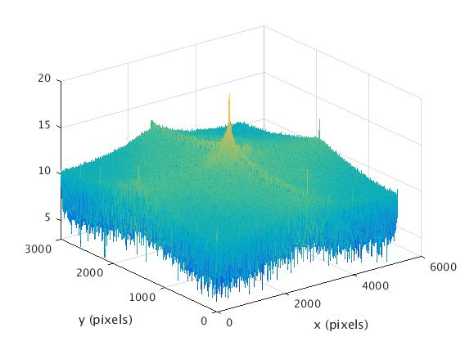
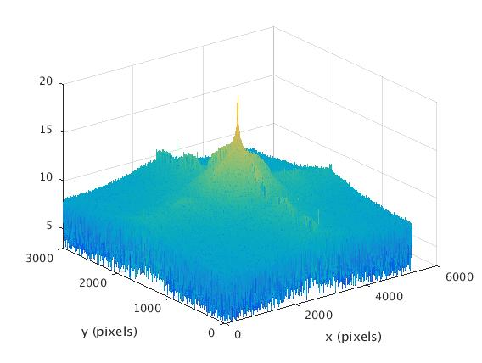
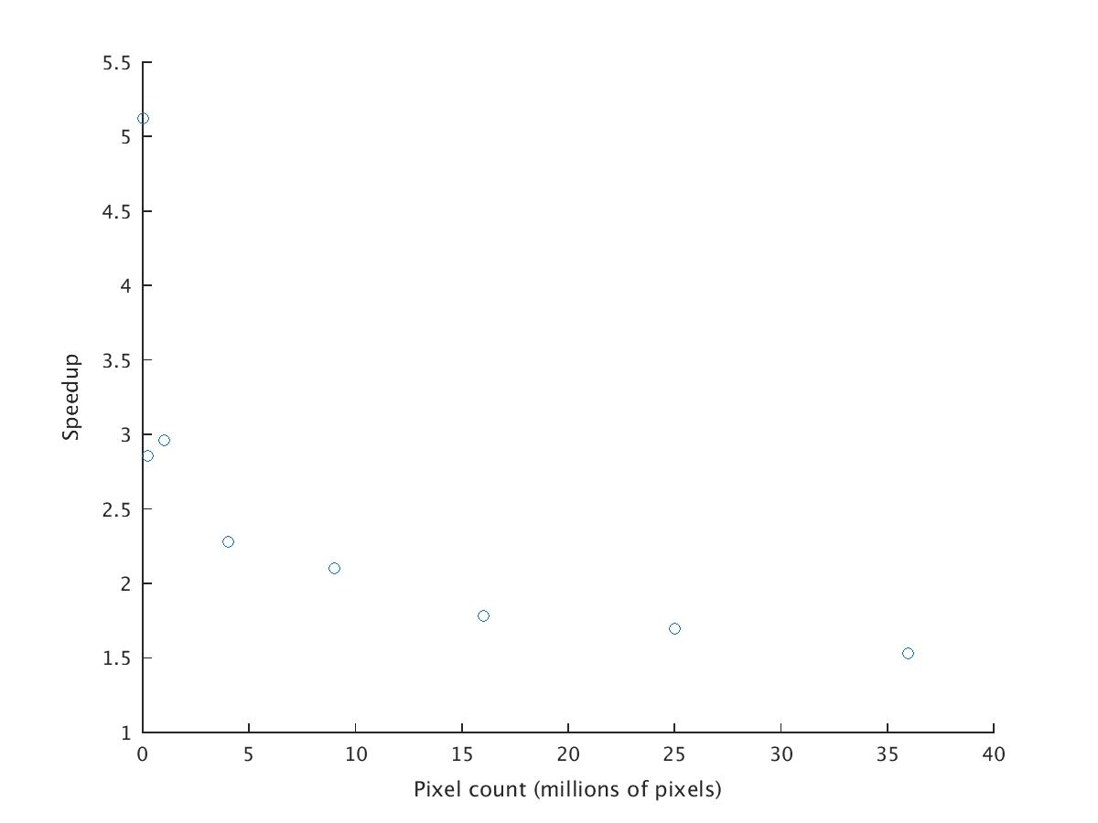
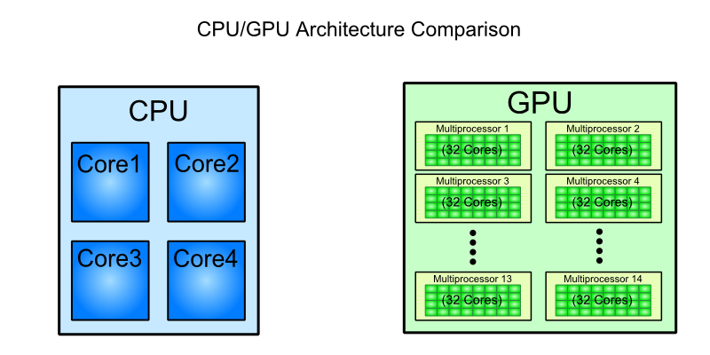
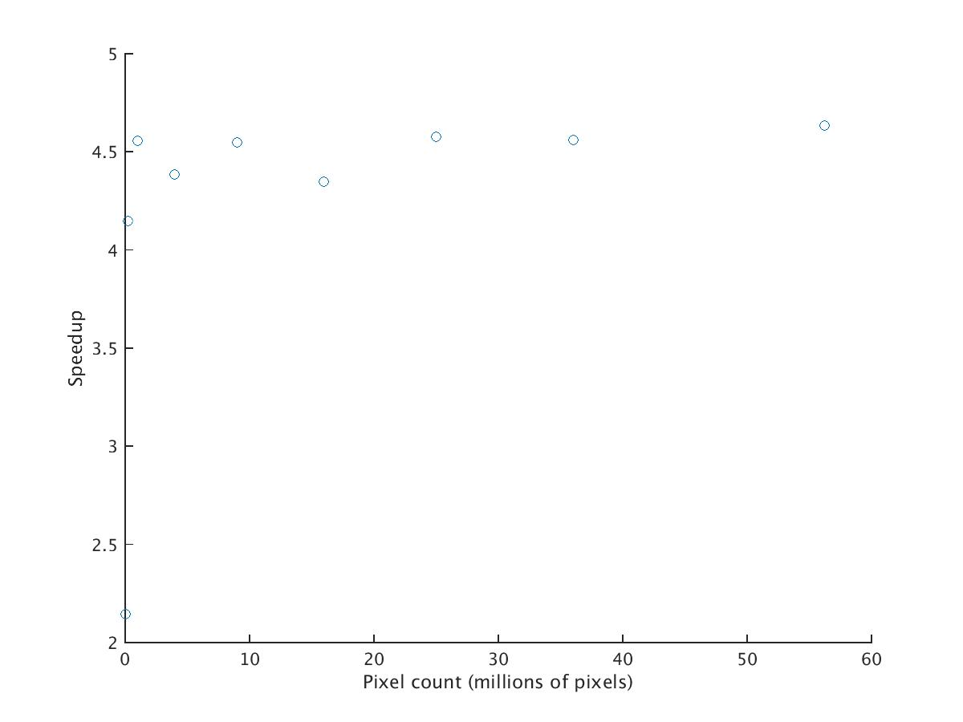
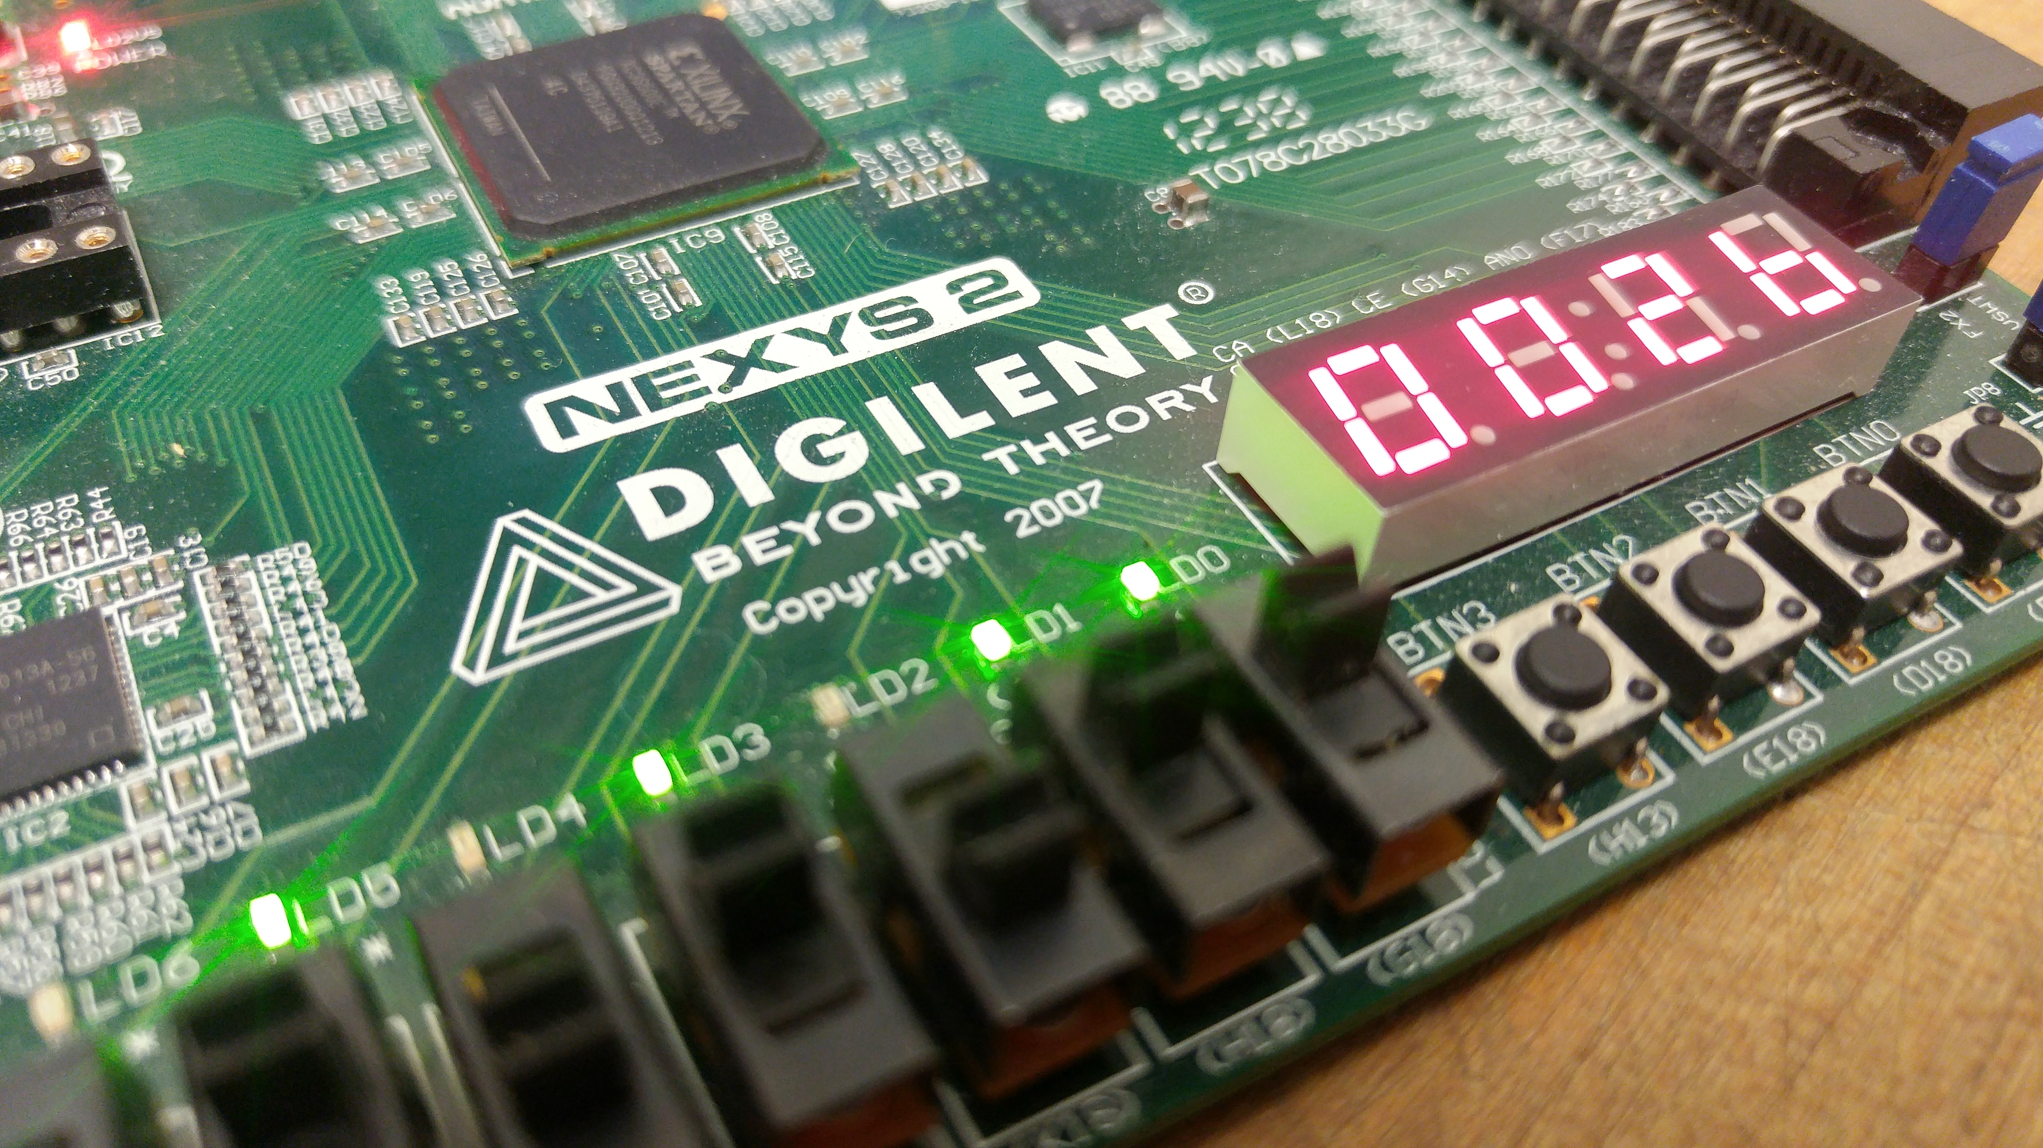
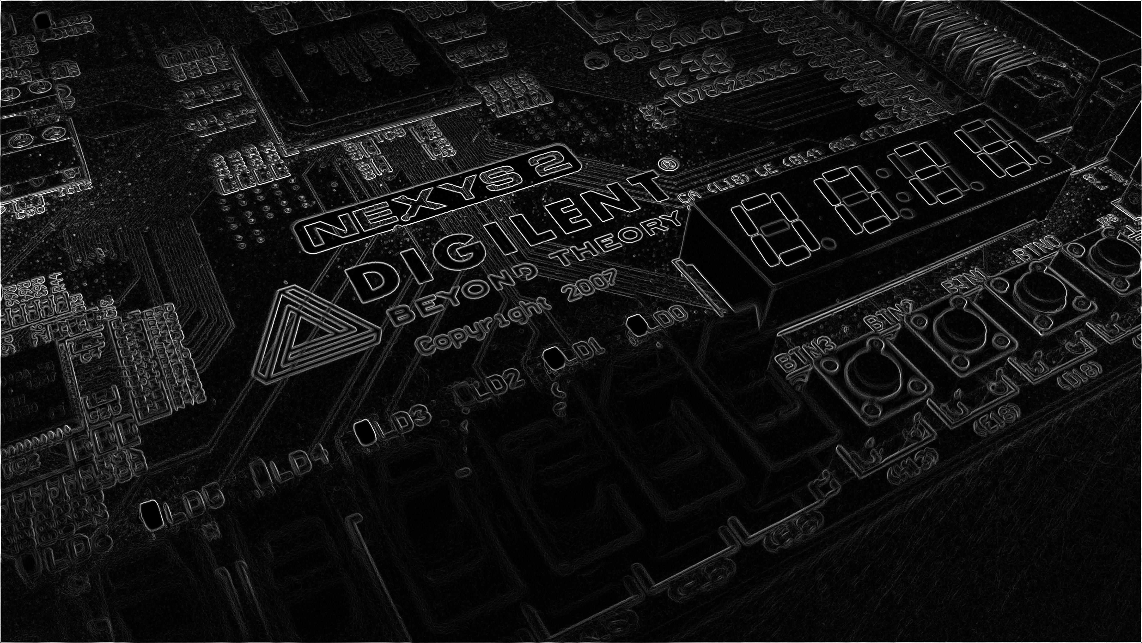
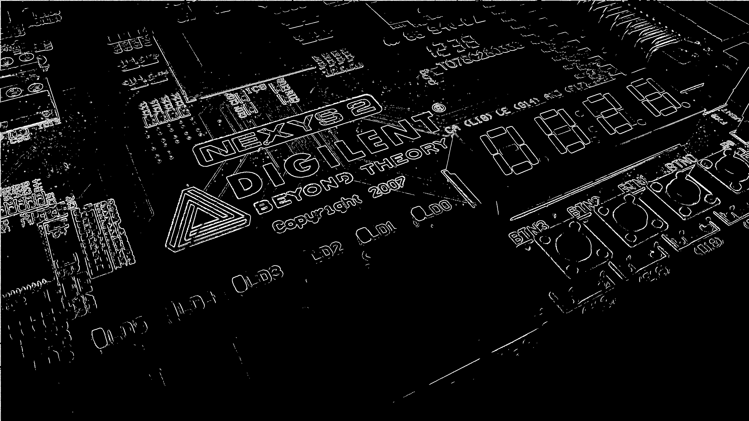
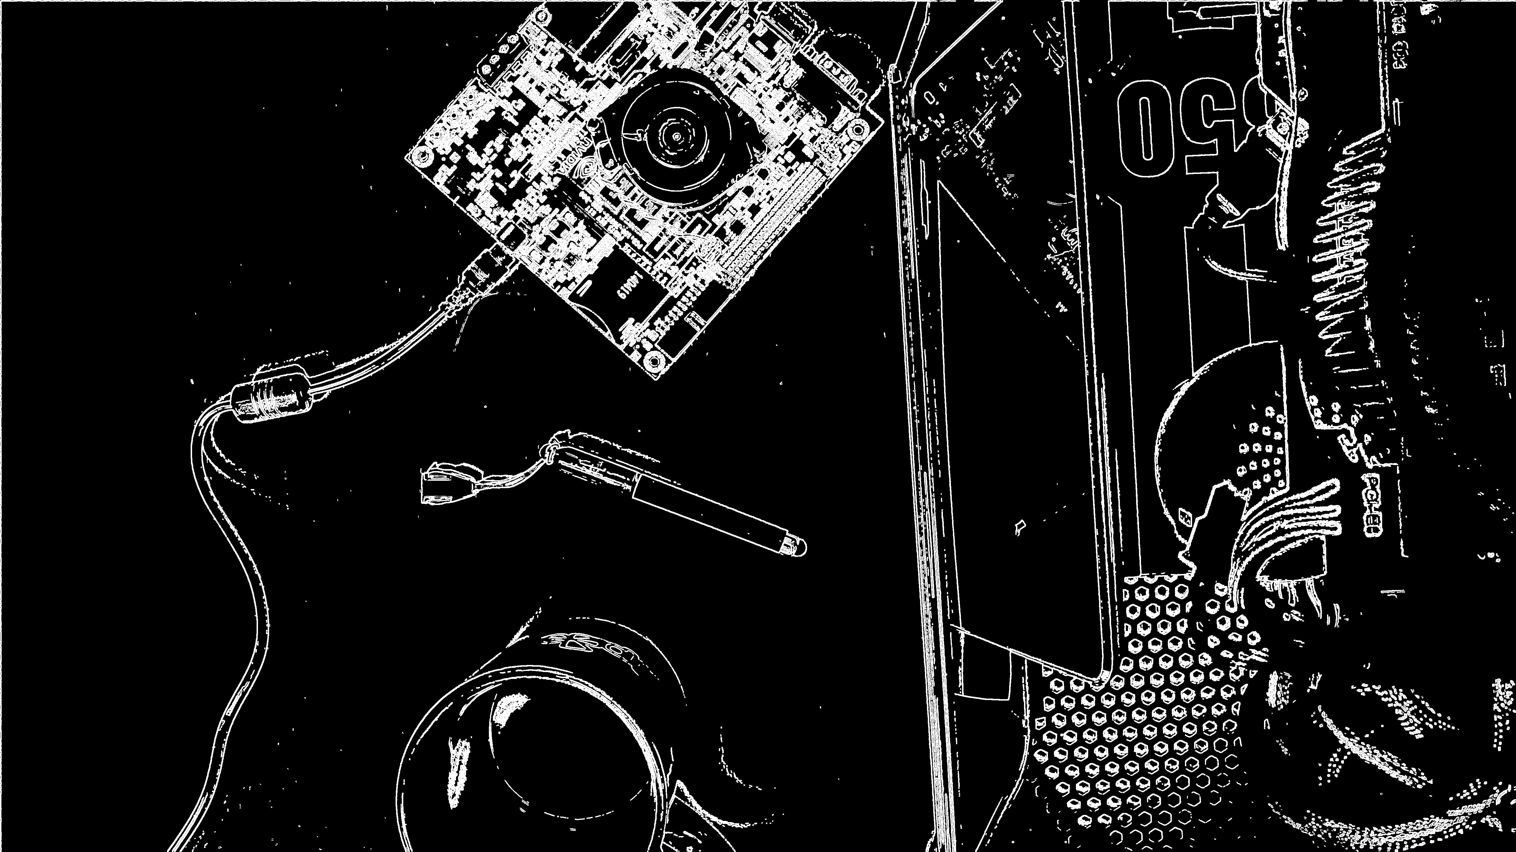

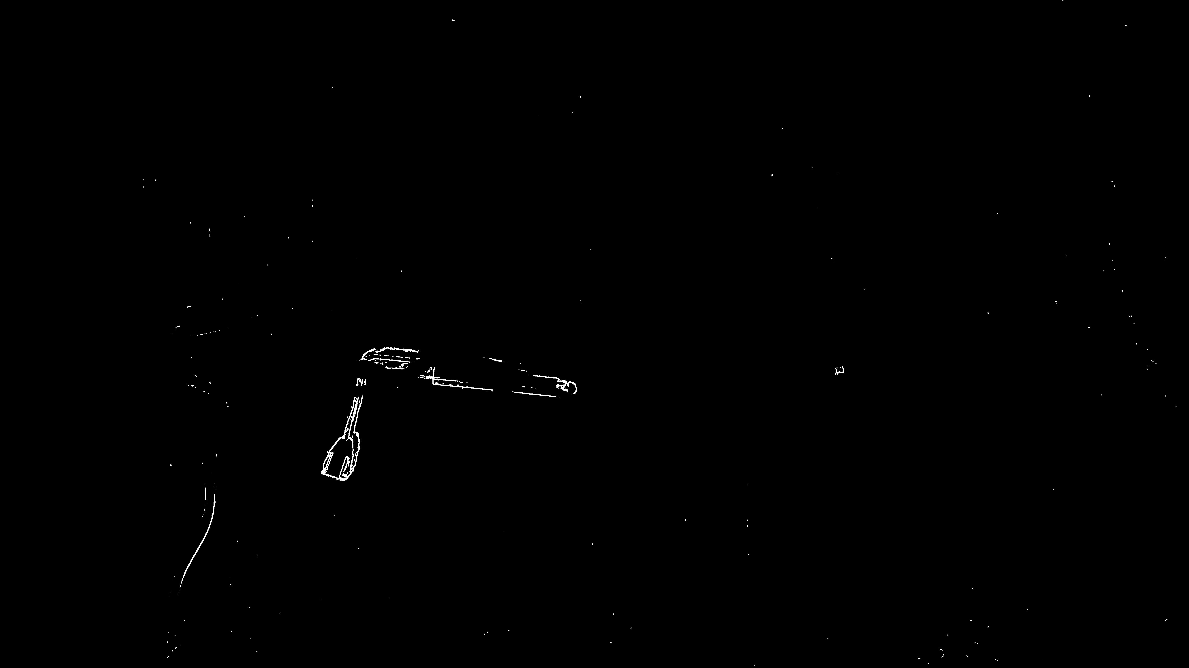
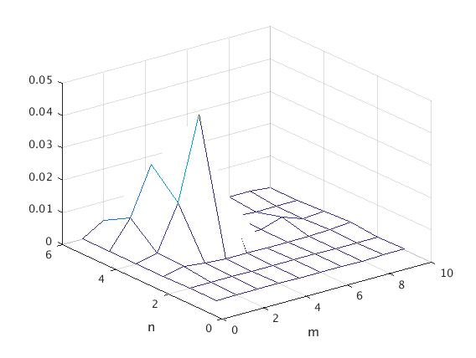


GPU-Accelerated Parallelization of Common Computer Vision Applications
Emilio Del Vecchio, Kevin Lin, Senthil S. Natarajan
I. Introduction
III. Edge Detection Implementation
V. Speedup Results
-Graphics Processing Units (GPU’s) have recently become popular for their ability to parallelize computations and achieve much greater efficiency as compared to the serial implementation of a CPU.
1) Reduce high frequency noise from the image using a 2D lowpass filter.
VS
Fig 1. The GPU’s parallel architecture allows it to parallelize massive computations.
Fig 1. FFT of grayscale noisy image- unfiltered (left) versus filtered (right)
2) Use a Sobel Filter to determine the 2D gradient of the filtered image.
3) Classify edges by suppressing gradients with magnitudes below a
certain threshold and applying selective thresholding around the pixels.
-Our objective: utilize the GPU’s ability to accelerate computer vision applications like facial recognition, edge detection, and motion tracking.
-Due to the proliferation of computer vision in many regular tasks, this affords us an opportunity to explore how to make such common tasks more efficient.
II. Facial Recognition
Fig 1. Original image (left), Sobel filter output (center), Final edges (right)
III. Motion Tracking Implementation
Compute edges of two separate frames.
VI. Conclusion and Limitations
Fig 1. Original frame (left), frame after movement(right)
-HAAR cascade classifiers turn up a relatively high rate of false positives in facial recognition. (next -> HOG)
2) Create a difference matrix by measuring the change in edge gradients.
3) Apply thresholding to suppress false positives (like camera shakes).
Fig 1. Difference in edge gradients (left), spatial density map (middle), motion area estimation (right)

